Slide 1
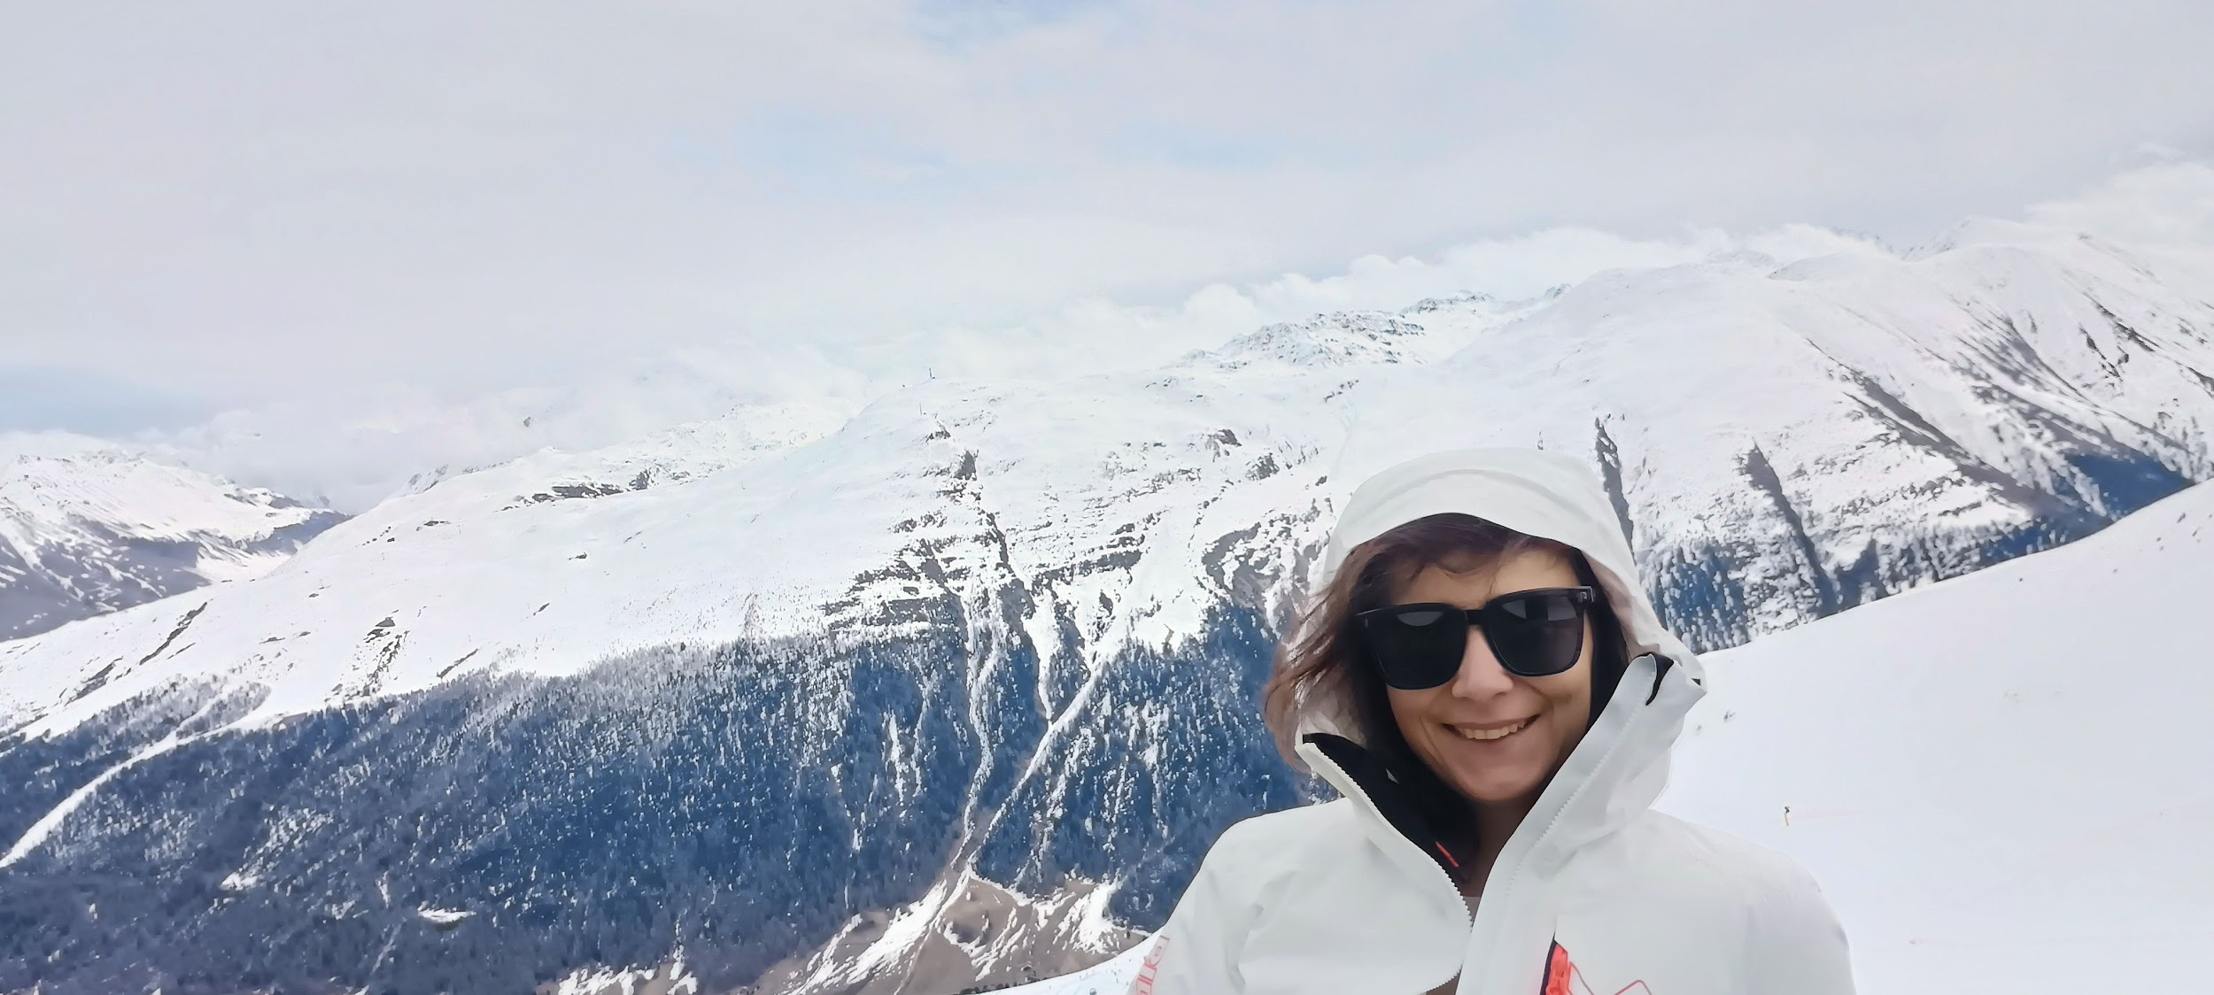

Hi!
The 2026 Olympic Games offer a unique chance to experience the thrill of elite athletic competition — the challenges, the triumphs, and the unforgettable moments that make the Games so electrifying.
Let’s spark our Olympic spirit and dive into the world of downhill skiing together, so we can fully savor every second of the spectacle.
Lucy

Slide 2
The Winter Olympics 2026

Slide 3
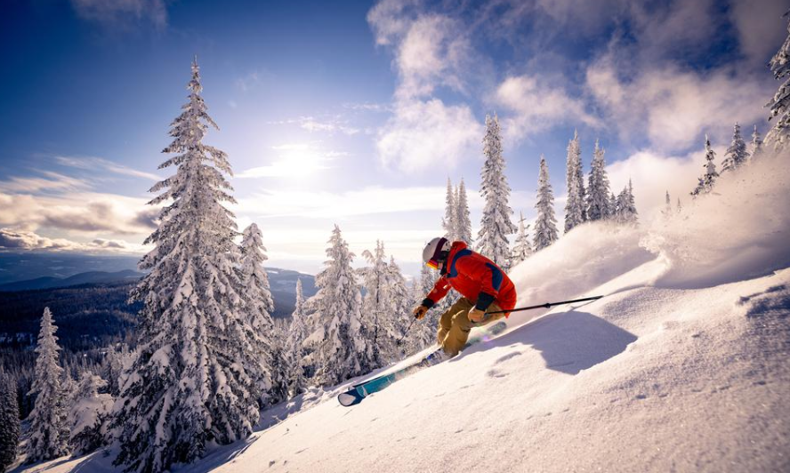
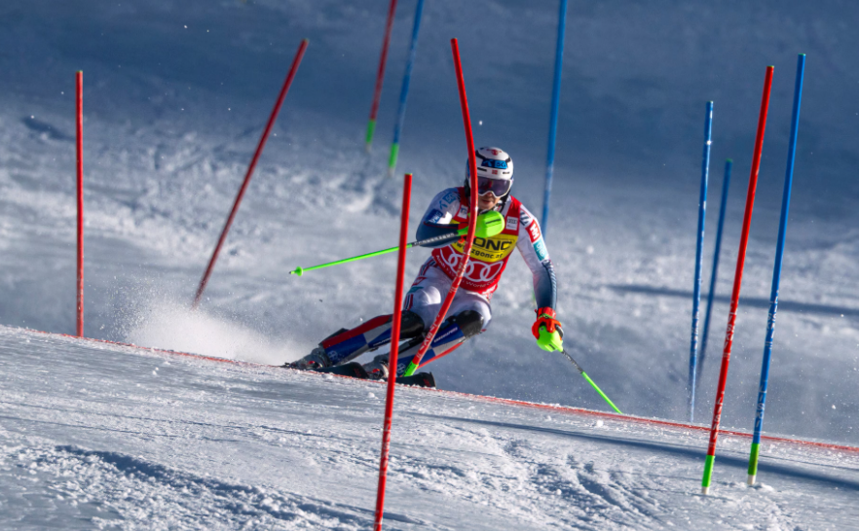
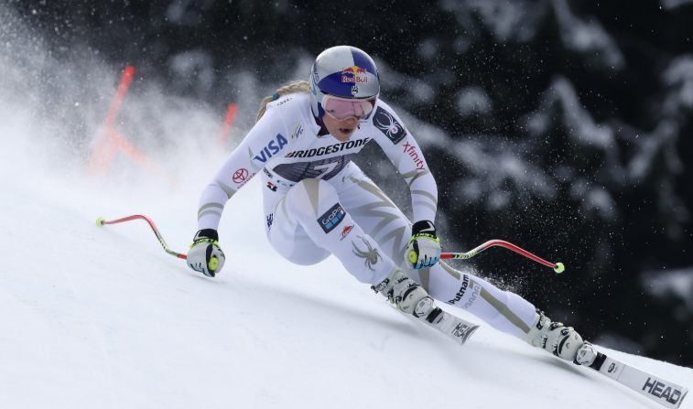
The interdisciplinary
crash course
on the alpine skiing

Slide 4
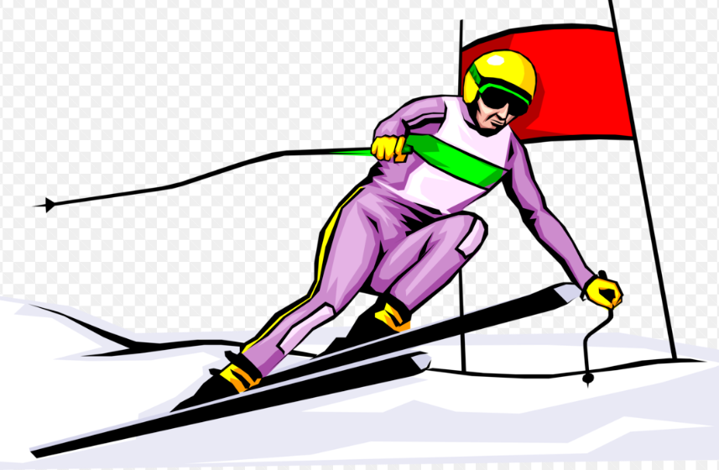
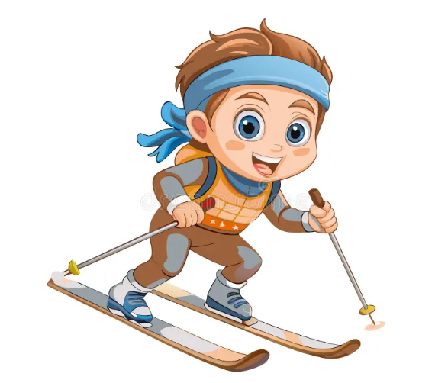
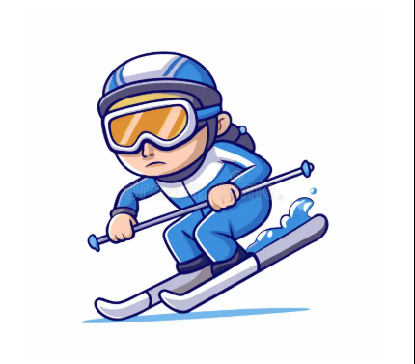
Let’s go on a ride…
Imagine you are an alpine skiing athlete…

Slide 5
Questions:
What are the Winter Olympic Games?
Where is this event happening?
What is the modern alpine skiing technique?
What are the alpine skiing disciplines?
What is my style?!

Slide 6
What are the Winter Olympic Games?

Slide 7
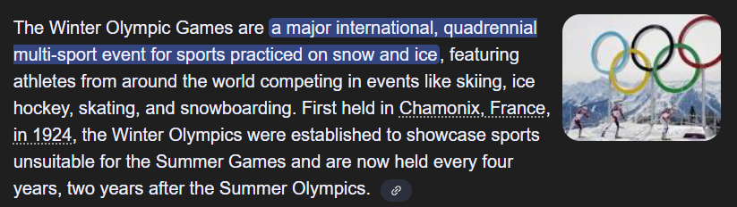
The Winter Olympics 2026
When: Fri, Feb 6, 2026 – Sun, Feb 22, 2026

Slide 8
Where is this event happening?

Slide 9
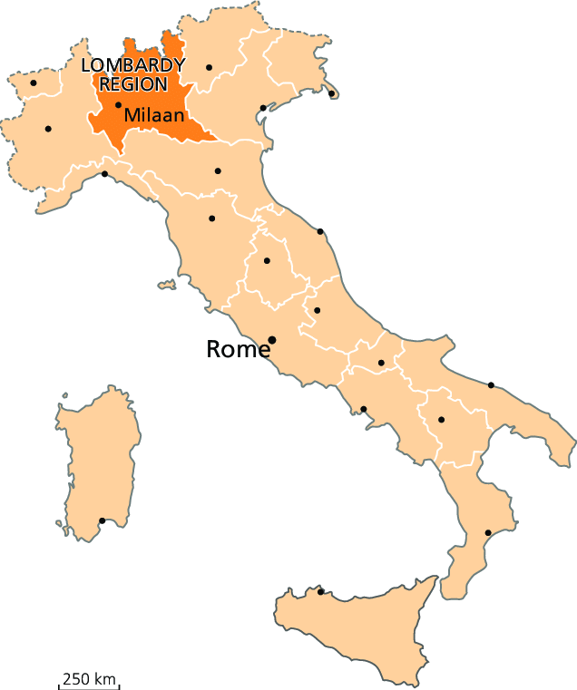
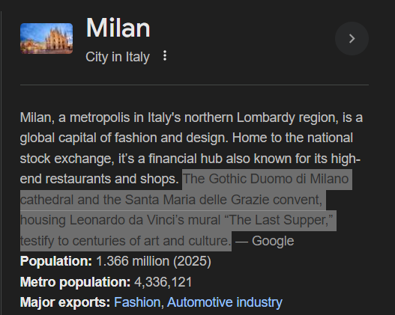
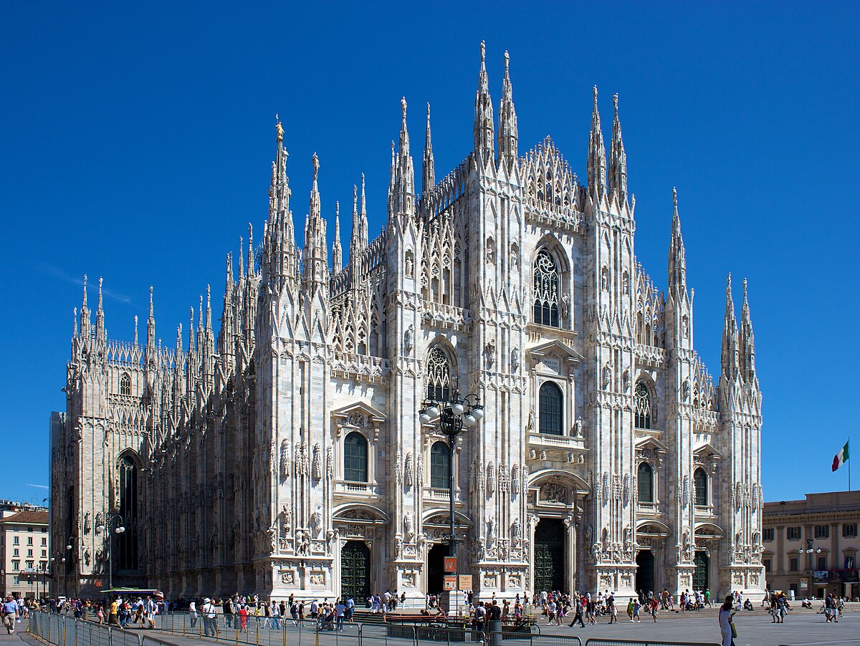
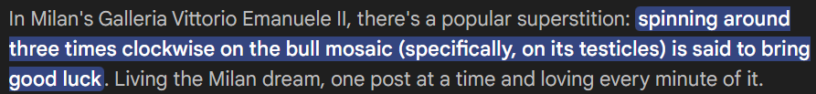
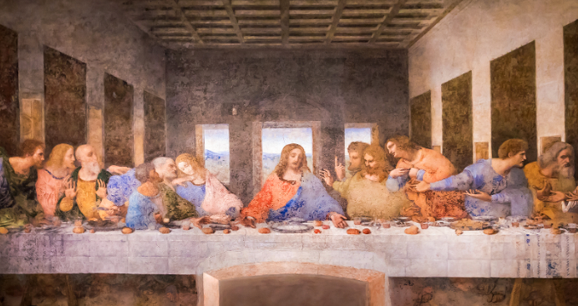
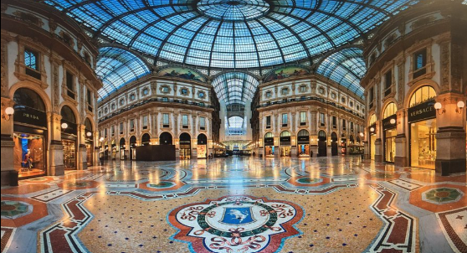
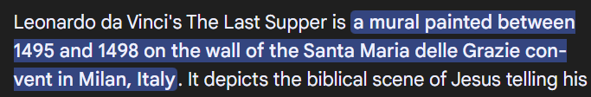
Hosting regions:
Milan city
The Duomo cathedral
The construction of Milan's Duomo Cathedral took almost six centuries, beginning in 1386 and concluding with the completion of its final details in 1965. This means the grand Gothic cathedral was built over a span of approximately 579 years!

Slide 10
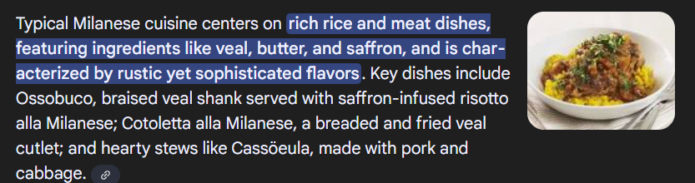

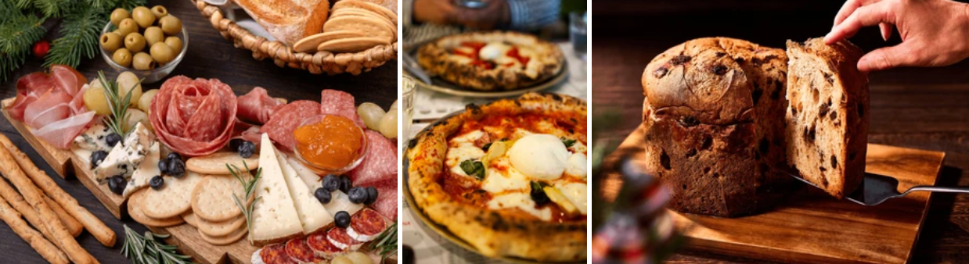

What would be a trip without a local foodie!
Milan

Slide 11
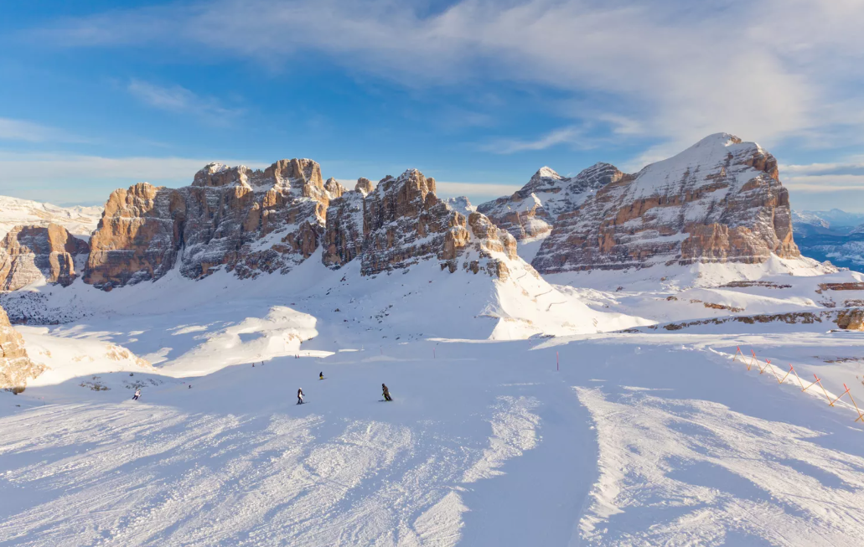
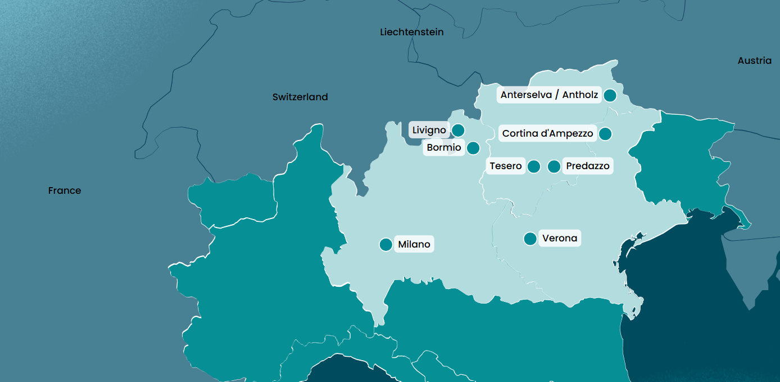
Hosting regions: Cortina d’Ampezzo

Slide 12
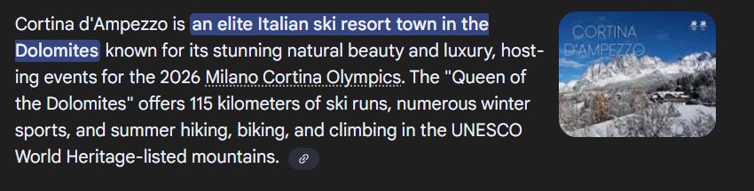
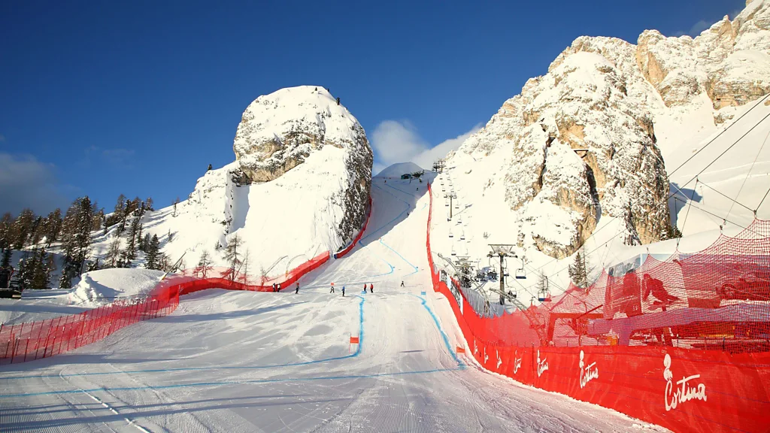
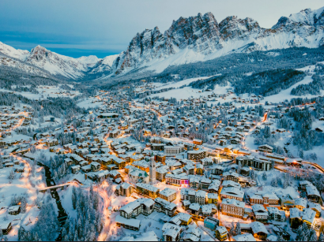
Section Title

Slide 13
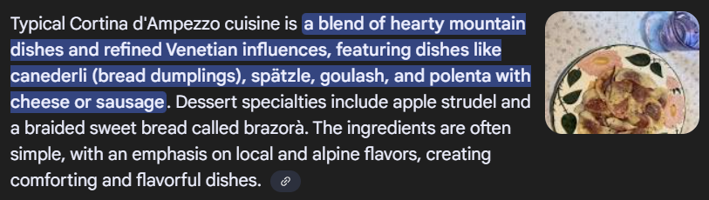
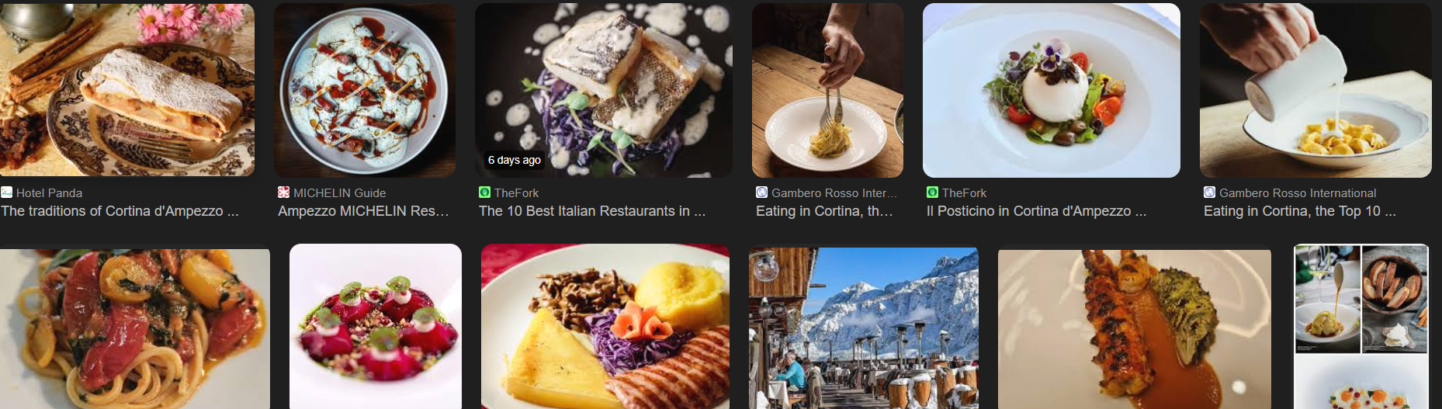

Let’s do not forget about the foodie!
Cortina D’Ampezzo

Slide 14
What is the modern alpine skiing technique?

Slide 15
Let’s talk alpine skiing!
That’s what interests me the most about the Winter Olympics xD

Slide 16
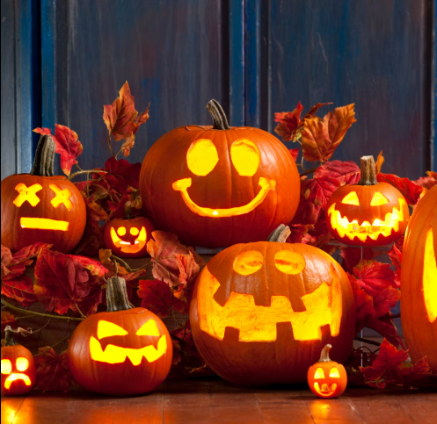
The carving technique

Slide 17
The carving technique
Not that one,
The other one…

Slide 18
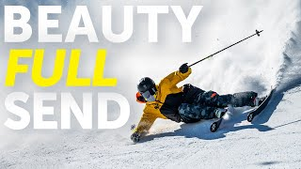

Slide 19
The physics behind skiing

Slide 20
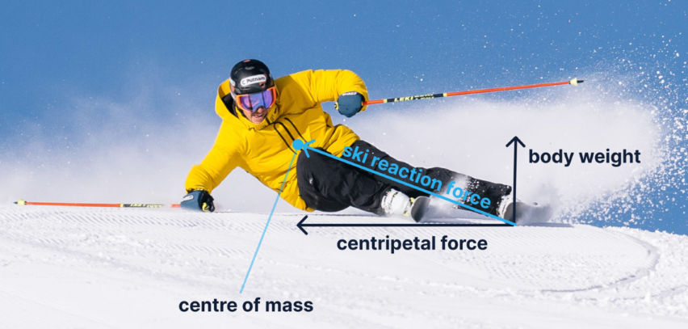
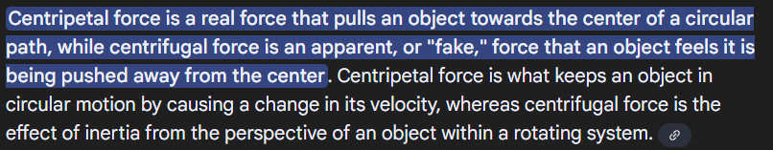
The carving technique in skiing
In modern carving, key forces include gravity, which provides initial momentum and downward force, centripetal force (felt as high G-forces), which keeps the skier on a curved path, friction (both static and kinetic), which opposes motion, and snow resistance, which provides the necessary support and allows for the ski's edges to "grip" the snow and create the arc.
These forces work in harmony with the skier's muscles, posture, and the ski's design to enable a high-speed, smooth, and controlled turn with minimal skidding.

Slide 21
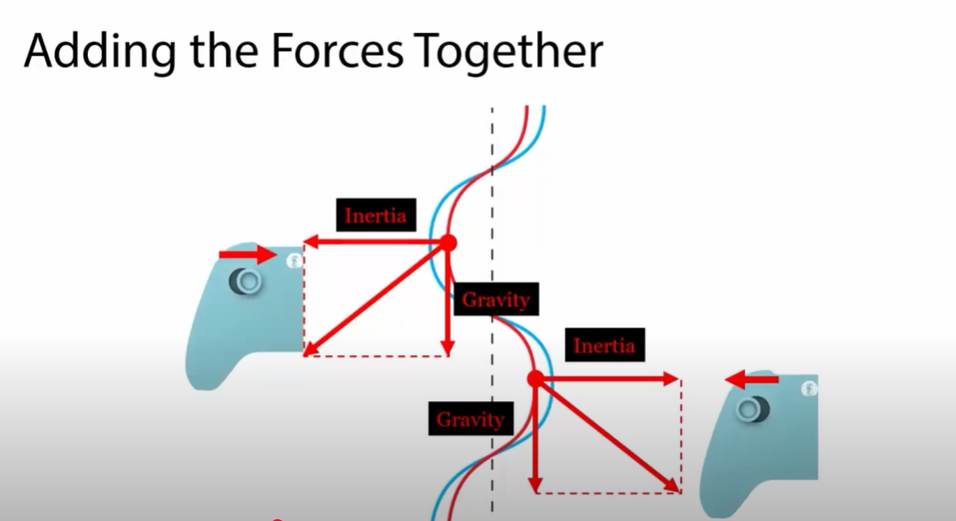
Carving for gamers

Slide 22
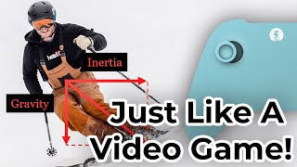
Carving “foot” pad

Slide 23
The ski

Slide 24
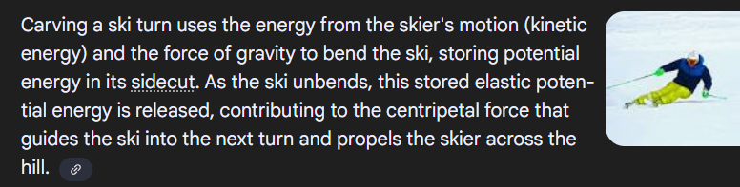
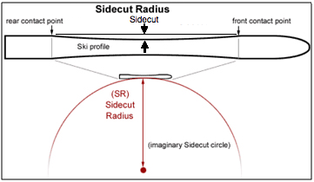
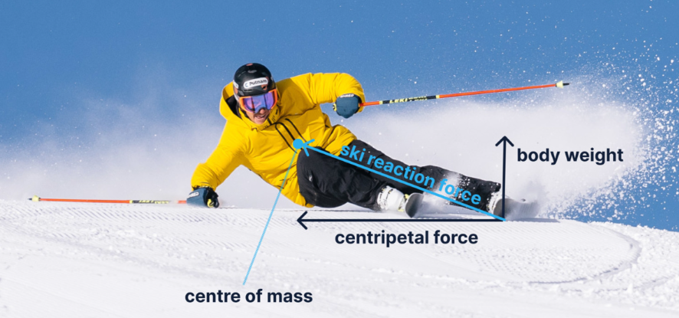
Carving skis
Think
“a horizontal trampoline!”

Slide 25
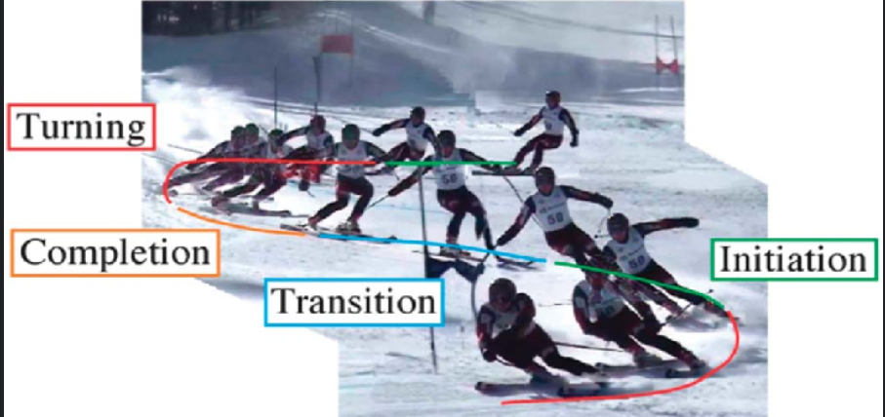

Slide 26
The physiology of the effort

Slide 27
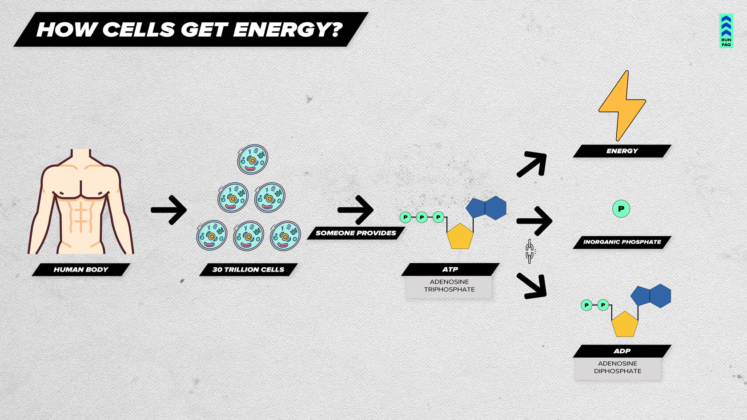
Energy sources in downhill skiing
Source: https://runfaq.com/everything_is_connected
How do our cells get energy?
Our body consists of trillions of cells, and each one generates energy in the same way:
by using ATP (Adenosine Triphosphate).
ATP is a molecule with three phosphate groups. The bonds between these groups store significant energy. When one phosphate group is ripped off, it releases energy for the cell to use.

Slide 28
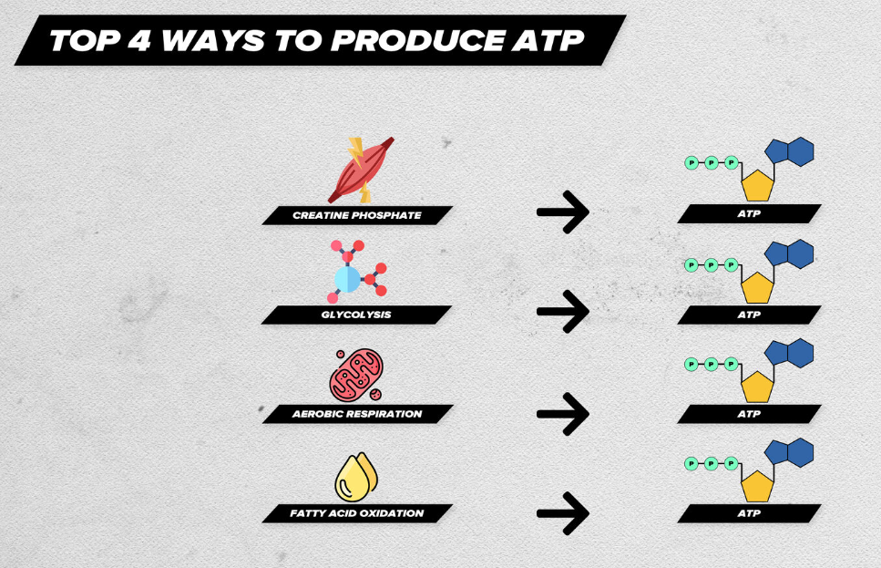
Energy sources in downhill skiing
Source: https://runfaq.com/everything_is_connected
Where do our cells get ATP?
The body has over 20 different ways to create ATP.
The four main pathways are:
Creatine Phosphate System
Glycolysis
Aerobic Respiration
Fatty Acid Oxidation

Slide 29
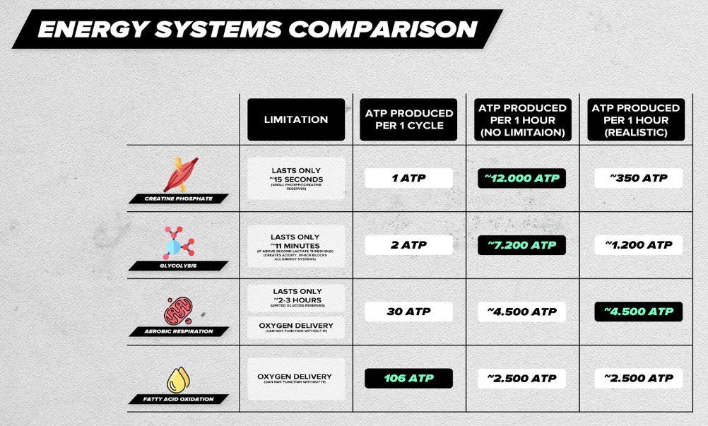
Energy sources in downhill skiing
Source: https://runfaq.com/everything_is_connected
Limitations
We have four sources of ATP.
The main limitation for two of them is oxygen — without it, they won’t function.
The limitation of the Creatine Phosphate System is that there is only a small amount of Creatine Phosphate available in the body, so it doesn’t last long.
As for Glycolysis, its limitation is it produces a large number of protons, which make the environment more acidic and therefore, it also can not last long if we use it on a maximum capacity.

Slide 30
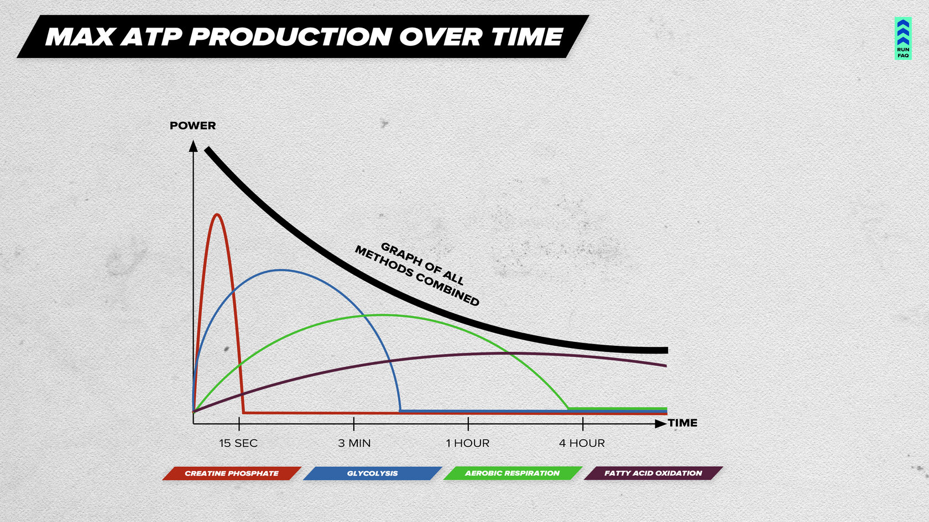
The graph of the maximum possible power output over time
Source: https://runfaq.com/everything_is_connected
The graph shows the relationship between the power we can achieve during an exercise and the duration of the exercise.
Worth noting, that this graph is only about maximum effort.

Slide 31
What are the alpine skiing disciplines?

Slide 32
Ready to hit the slopes?! 😼
Winter Olympics 2026
Fri, Feb 6, 2026 – Sun, Feb 22, 2026

Slide 33
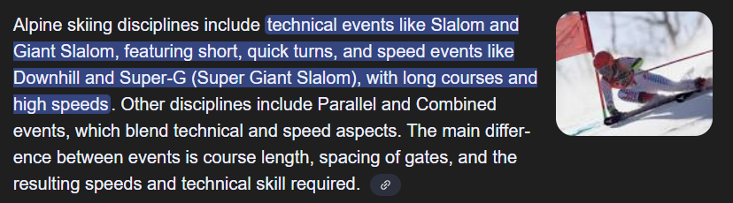
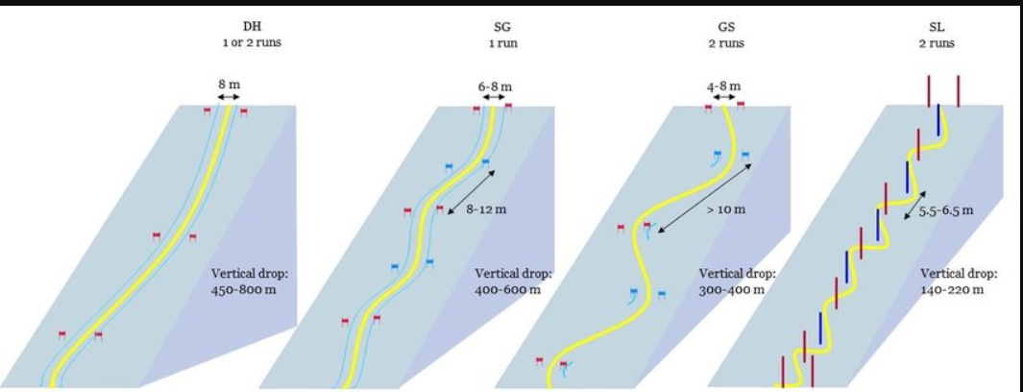
Alpine skiing

Slide 34
Alpine skiing
Competitive Alpine Skiing Disciplines
These are time-based events involving racing down a course marked by poles called gates.
Slalom: The most technical event, featuring short, tight turns through closely spaced gates.
Giant Slalom: A bigger version of slalom with wider turns and more space between gates.
Super-G (Super Giant Slalom): A combination of the speed of downhill and the technical turning of giant slalom, with fewer turns and wider gate spacing than giant slalom.
Downhill: The premiere speed event, featuring long courses with widely spaced gates and extremely high speeds.
Combined: A single event that consists of a downhill run and a slalom run, with the times from both combined to determine the winner.
Parallel: A knockout format where multiple skiers race side-by-side down identical, short courses.

Slide 35
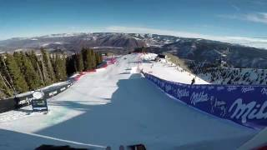
Downhill run view. How fast they go?
Potentially disturbing sounds.
Consider turning the volume down.

Slide 36
Downhill skiing max speed?
For World Cup downhill skiing,
average speeds typically range from 60–70 mph (97–113 km/h),
with top speeds reaching 75–95 mph (121–153 km/h) on certain course sections. 😮
The fastest Olympic downhill to date had
an average speed of 67.8 mph (109 km/h),
While the official speed skiing world record for men is
158.76 mph (255.5 km/h), achieved in a discipline focused solely on maximum velocity. 😮

Slide 37
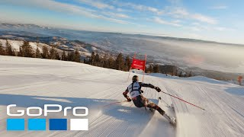
Slalom Gigant chase cam view
Potentially disturbing sounds.
Consider turning the volume down.

Slide 38
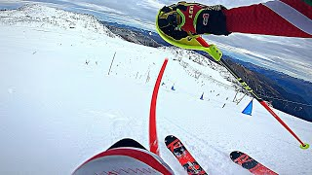
Slalom run view
Potentially disturbing sounds.
Consider turning the volume down.

Slide 39
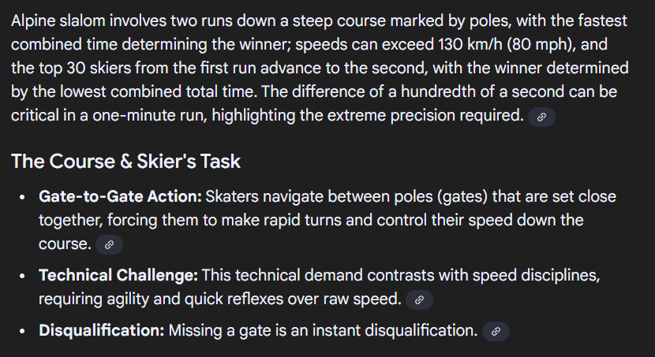
Slalom = a technical sprint

Slide 40
Which is the dominant energy source in alpine skiing?
Source: https://runfaq.com/everything_is_connected
Quiz time!

Slide 41
The answer

Slide 42
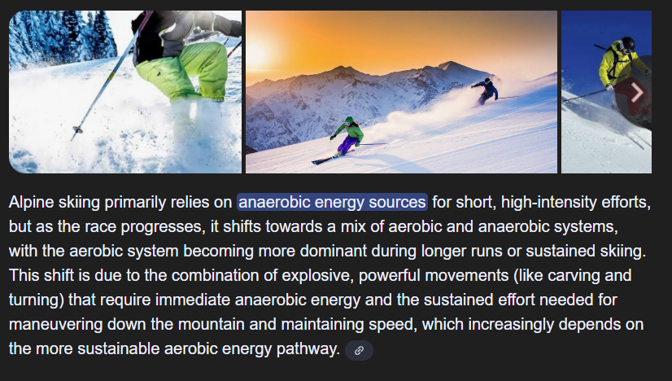

Slide 43
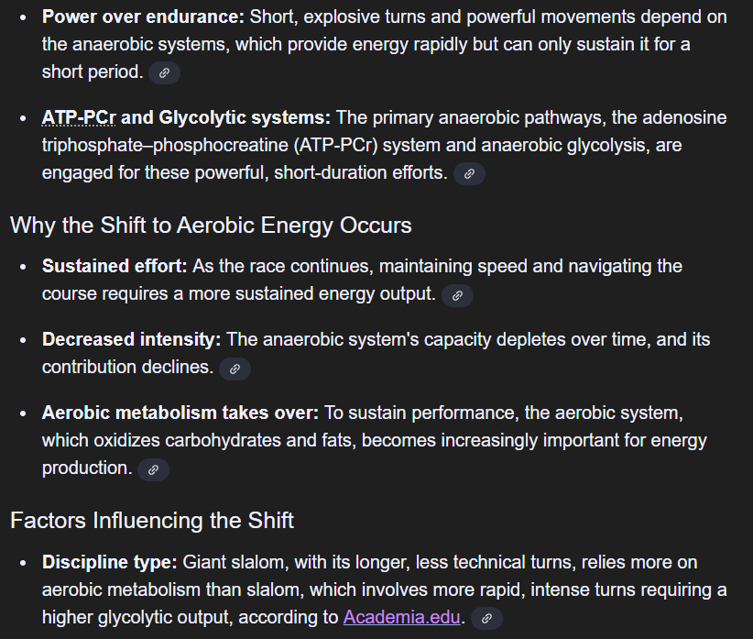
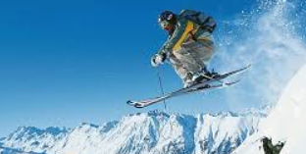
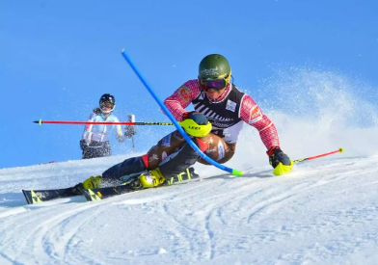

Slide 44
What is my individual style?!

Slide 45
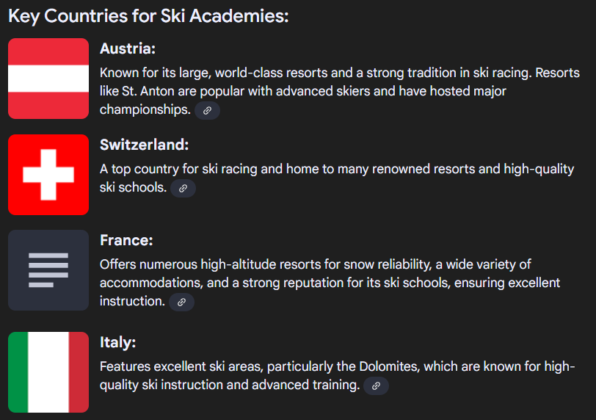
Informal ranking of the best downhill skiing academies in Europe

Slide 46
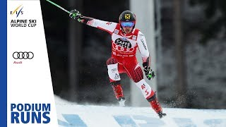
The Austrian “stable” style
Style:
Stable
Rhythmic
Anchored
Harmonious
Classic Music alike

Slide 47
An alternative
Represented by my fav skiing athlete of all times
…

Slide 48

Style:
Bold
Brave
Risk taking
Adventurous
Spectacular
Bode’s style

Slide 49


How it ended?
Bode Miller
is one of the most decorated American alpine skiers,
with his official "sport scores" including:
🏆six Olympic medals (one gold, three silver, two bronze),
🏆five World Championship medals (four gold, one silver),
🏆two World Cup overall titles,
🏆and 33 World Cup victories.
He is also the only U.S. male skier to win a World Cup race
in all five disciplines: downhill, super-G, giant slalom, slalom,
and combined.
As they say: “Take the risk. You will die anyway”.

Slide 50




How it started?
Free range

Slide 51

Crazy
moments in skiing. 😏

Slide 52
Crazy
moments in skiing. 😏

Slide 53
Quiz time!
What would be your favorite alpine skiing discipline (if you had to choose)

Slide 54
Vote with the emoji.
If your favorite alpine skiing discipline is:
- Downhill: comment 😅
Slalom Gigant: comment 👍
Slalom: comment 🎉

Slide 55
Haven’t found anything interesting for yourself?
Don’t look further
Skiing won’t let you down..

Slide 56
What else has skiing to offer?

Slide 57

Freeride/Freestyle bar is high these days

Slide 58

*Do not try it at home
Parachute skiing

Slide 59

and finally Kite skiing

Slide 60

Fall 2025. 1st person ever to climb and ski-descent the Mt.Everest without an extra oxygen

Slide 61
Energy sources in downhill skiing
Source: https://runfaq.com/everything_is_connected
Where do our cells get ATP?
The body has over 20 different ways to create ATP.
The four main pathways are:
Creatine Phosphate System
Glycolysis
Aerobic Respiration
Fatty Acid Oxidation

Slide 62
The conclusion

Slide 63
The Sky
The Top of the world
is (NOT) the limit .
Keep carving your lines
&
Watch (or not)
the Winter Olympic Games 2026!

Slide 64

Thank you!
You were a great audience!
Lucy

